Slide 1
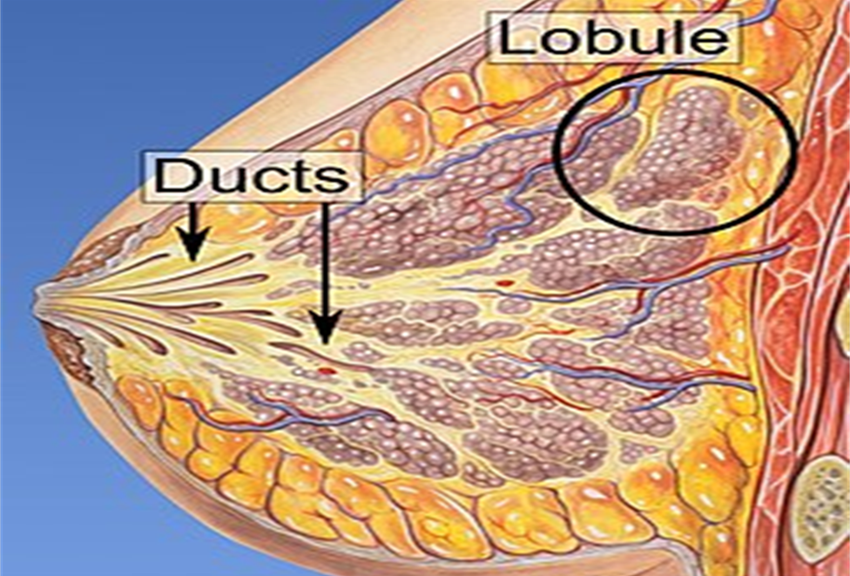
Improving Breast Cancer Detection with Deep Learning
Predicting Invasive Ductal Carcinoma in Breast Cancer Tissue Slices

Slide 2
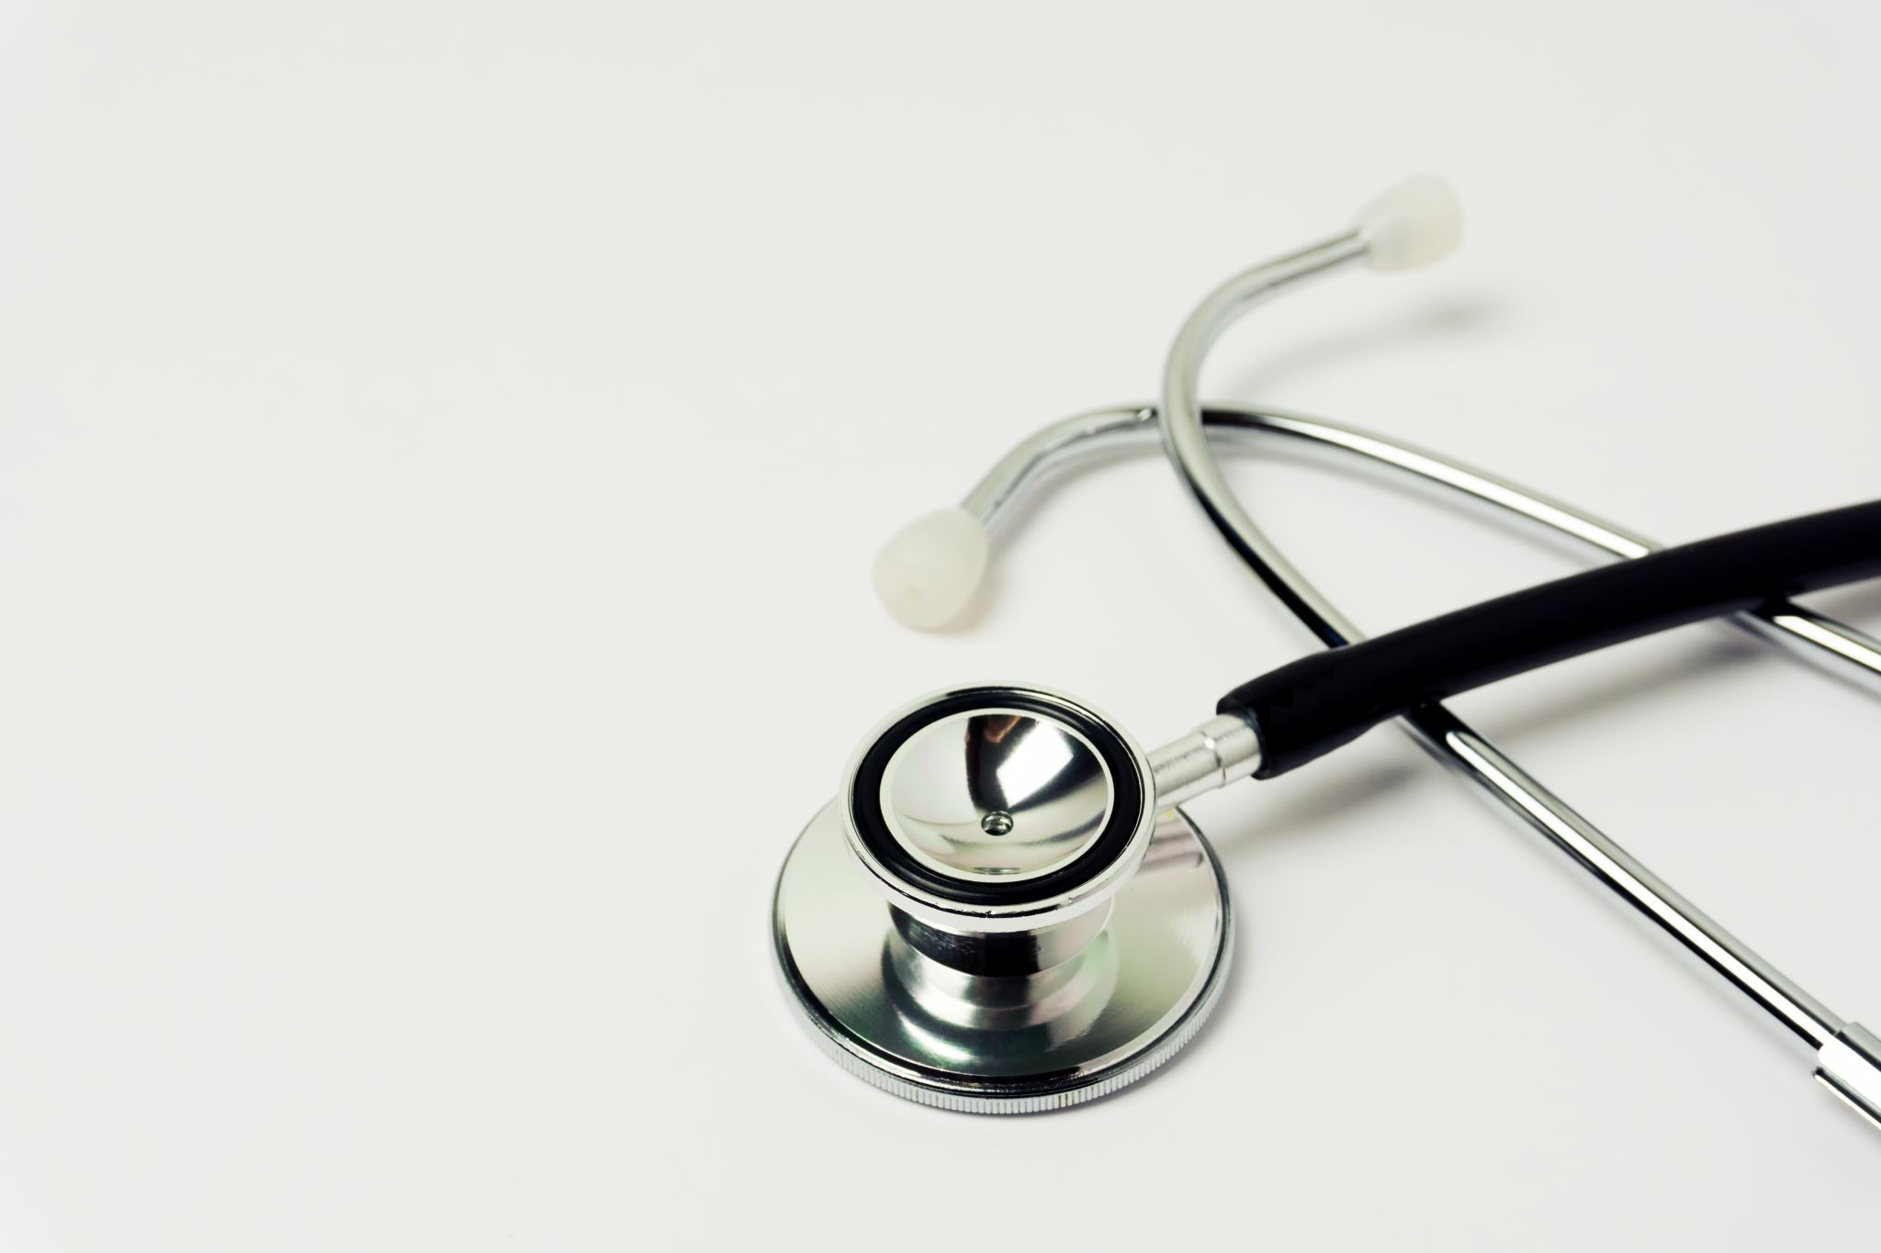
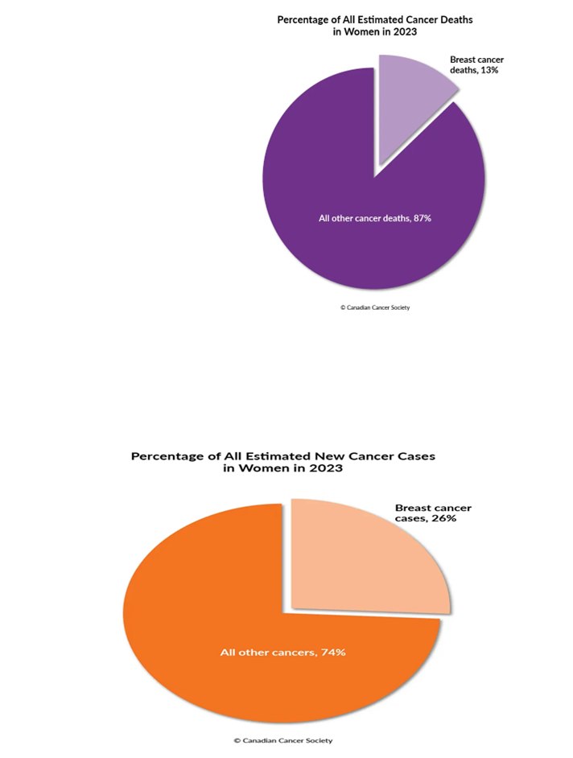
Introduction
Breast cancer is one of the leading causes of cancer-related deaths worldwide with IDC being the most common type. Early detection is crucial for effective treatment and improved patient outcomes. However, current detection methods often lack accuracy and reliability. Our project aims to improve breast cancer detection using deep learning techniques.

Slide 3
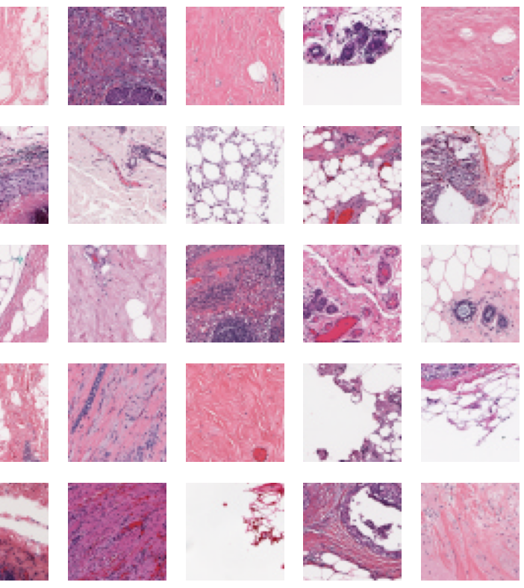
Exploring the Data
Data Loading: Total number of images: 277,524. Dimensions: 50x50 pixels, Labels: IDC (Invasive Ductal Carcinoma) and non-IDC.
Each image is a 50 x 50-pixel image that belongs to one of 279 patients.
For each patient, we had a full whole mount slide image at a very high resolution and then this 50 x 50 images were then extracted from them for form our dataset.

Slide 4
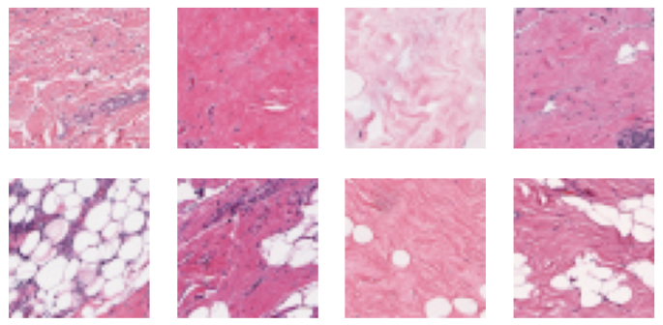
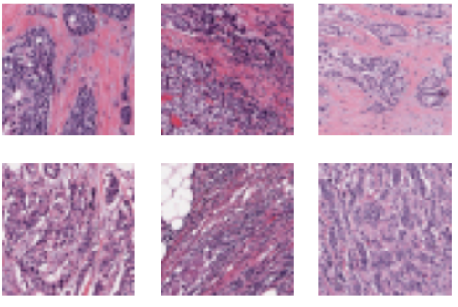
2 Histopathology Images showing Negative and Positive IDC
Negative Patches
Positive Patches

Slide 5
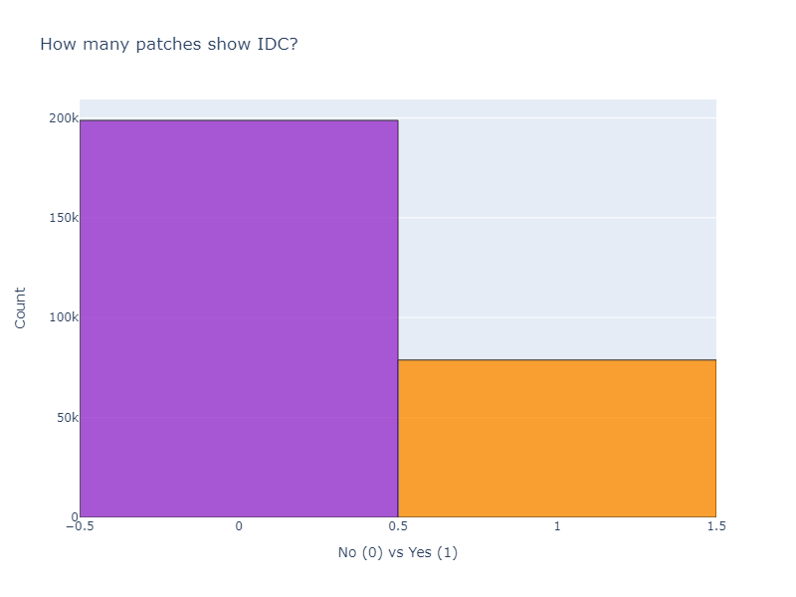
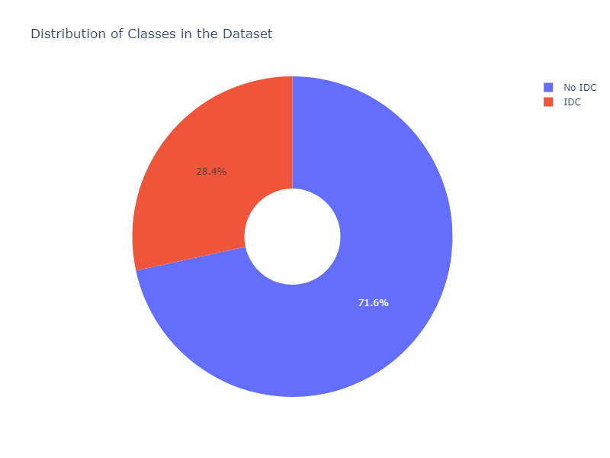
Class Imbalance
As with most real-life applications, we are often face with an imbalanced dataset.
We discuss how we handle this in later sections.

Slide 6
Experiments Overview
Conducting experiments using a CNN model from scratch(vanilla), and some transfer learning with VGG16, and ResNet50 architectures.
We have chosen to use these because we know convolutional neural networks are well suited for image classification tasks and it is always a good idea to fine tune pretrained models to use as classifiers for your specific task as we have seen earlier in the class.

Slide 7
Handling Class Imbalance
We chose to handle the class imbalance in our dataset by using the class weight method.
SKLearn has a nice method to do this.
class_weights = class_weight.compute_class_weight(
class_weight='balanced',
classes=np.unique(y_train),
y=y_train['target'])
class_weights = dict(enumerate(class_weights))
// class weights: {0: 0.6985221674876847, 1: 1.7593052109181142}

Slide 8
Data Preparation
Augmented dataset with rotation, flipping, and scaling. Trained models on augmented and non-augmented datasets.
Rescaled the RGB values of the images
Reshaped the images in the dataset to 180x180 pixels to match the model inputs.

Slide 9
Modeling (Vanilla CNN)
Here we use a simple convolutional neural network. It features two convolutional layers for feature extraction, followed by max pooling and dropout for regularization. The network includes a fully connected layer, another dropout stage, and a softmax output layer. It's compiled with categorical crossentropy loss and the Adadelta optimizer, trained with class weights to address class imbalance.

Slide 10
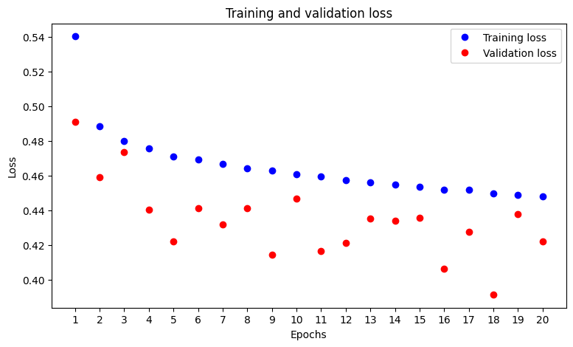
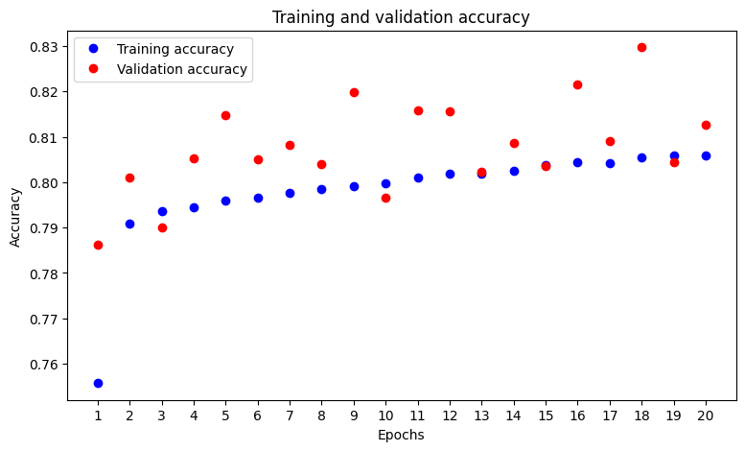
Modeling (Vanilla CNN)

Slide 11
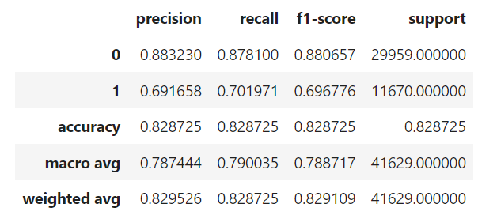
Modeling (Vanilla CNN)

Slide 12
Modeling (VGG16)
In this section, we finetuned the VGG16 model pre-trained on ImageNet. The base VGG16 layers are initially frozen, then the last four layers are fine-tuned to adapt to the specific dataset. It preprocesses our inputs for VGG16 compatibility, applies dropout for regularization, and includes a dense layer with dropout before the final softmax output. The model is compiled with categorical crossentropy and the Adadelta optimizer. It is trained using class weights to address imbalance, and saves the best model based on validation loss.

Slide 13
Modeling (VGG16)
We finetuned the VGG16 model pre-trained on ImageNet. The base VGG16 layers are initially frozen, then the last four layers are fine-tuned to adapt to the specific dataset. It preprocesses our inputs for VGG16 compatibility, applies dropout for regularization, and includes a dense layer with dropout before the final softmax output. The model is compiled with categorical crossentropy and the Adadelta optimizer. It is trained using class weights to address imbalance, and saves the best model based on validation loss.

Slide 14
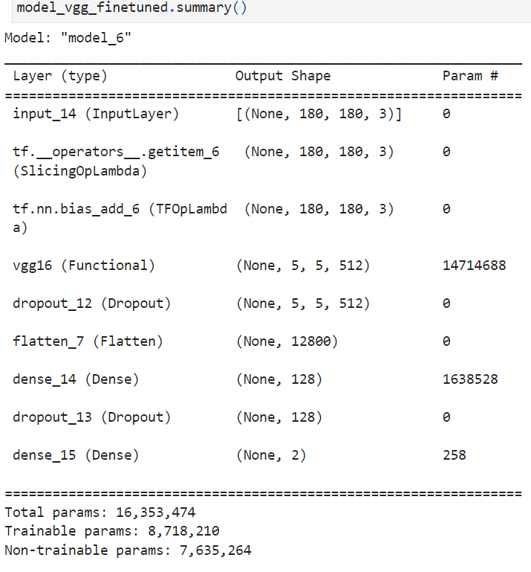
Modeling (VGG 16)

Slide 15
Modeling (RESNET50)
Here, this model integrates the ResNet50 architecture, pre-trained on ImageNet. The base ResNet50 layers are frozen to retain learned features, while additional custom layers include flattening, a dense layer, and dropout to combat overfitting. The final layer uses softmax for binary classification output. It's compiled with categorical crossentropy loss and the Adam optimizer. Training involves data augmentation, class weights for balancing, and callbacks to save improvements based on validation loss.

Slide 16
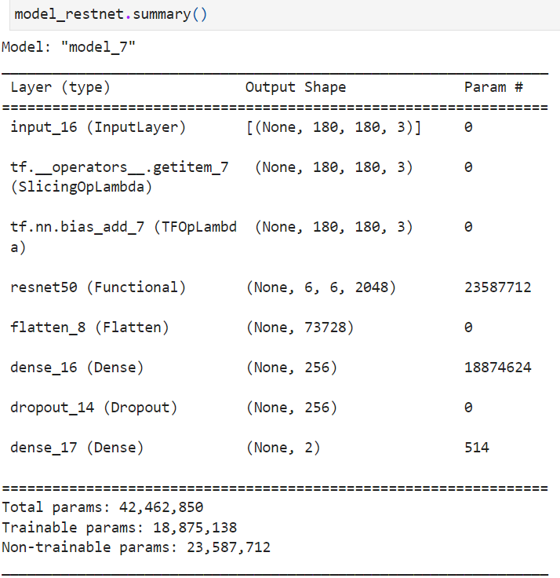
Modeling (RESNET50)

Slide 17
Modeling (RESNET50)

Slide 18
Summary of Results Put the 3 tables here
After evaluating our models on the test datset, some things to notice.
For our Vanilla model, this was our test performance.
Comparing the above, we can see that:
- the vanilla model had the best accuracy among all 3 models with 0.8287
- the VGG16 model had the best recall score on the positive class 0.723 but the Vanilla model is not too far behind on 0.702, this is very important.
- the vanilla model had the best average recall score in our dataset with 0.79.
Combining all the metrics, I can we can say that the vanilla model had the best performance for our dataset.

Slide 19
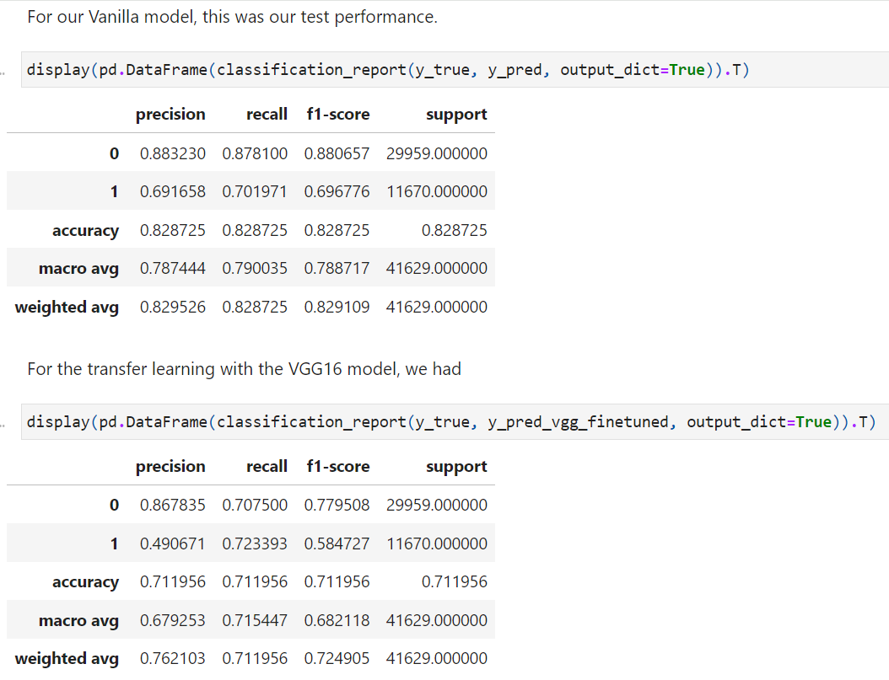
Summary of Results Paste my summary here

Slide 20
Precision/Recall Tradeoff
Precision Recall Tradeoff
When evaluating machine learning models designed for healthcare. The most important metric is the recall score. It is perfectly okay to sacrifice the precision and accuracy score in favour of the recall score.
One way to do this without retaining or modifying our model is to simple reduce the threshold you use in classifying a sample as positive. This way, it becomes harder for a patient that is positive to slip through our prediction. Ensuring that we don't send home a sick patient because our model predicted a false negative.

Slide 21
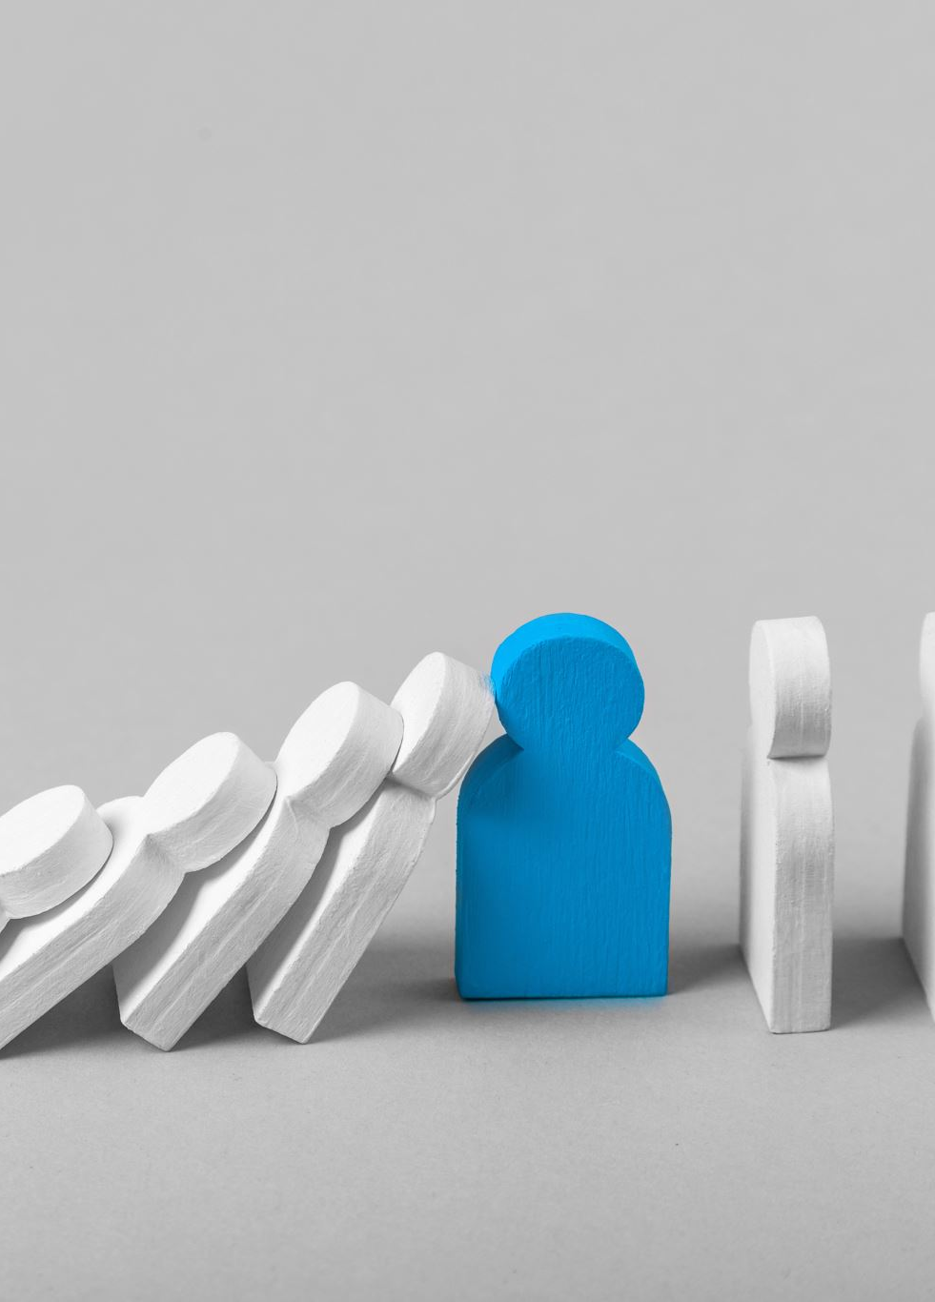
Lessons Learned
The performance of the transfer/pretrained models were not as good as I would have loved but not too surprising at the same time. These pretrained models were trained on daily life and everyday images, while our dataset is very niche, so they probably couldn't really help.
Trying a different approach for balancing the dataset.
Training for more epoch.
I also observed that when I played around with evaluating my test dataset with the last epoch from my fitting and not the best epoch, it had a better recall score than the best epoch.

Slide 22
Key Takeaways
Transfer learning can significantly improve classification performance in medical imaging tasks. Robustness and generalization are critical for real-world deployment of deep learning models. Achieving a balance between precision and recall is essential for reliable cancer detection.

Slide 23

Future Work
Further exploration of hyperparameter tuning techniques. Extension of the classification task to include multiple subtypes of breast cancer. Conducting clinical validation studies for real-world deployment.

Slide 24
Conclusion
Deep learning approaches hold promise for improving breast cancer detection. Our findings highlight the effectiveness of transfer learning, model robustness, and ensemble learning in predicting IDC in breast cancer tissue slices.

Slide 25
Q&A
Open floor for questions and answers.

